Slide 1


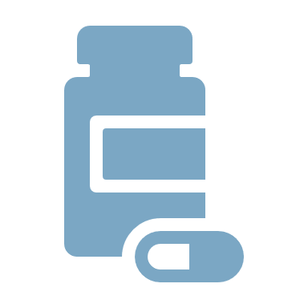
Project-
E-HEALTHCARE APPLICATION
Sub- Capstone Project
Course- Diploma in Computer Engineering
Guided By- Shubhangi S. Shiwankar
Institute Name- Dy Patil Polytechnic Ambi, Pune
Academic Year- 2025-2026
Group Members-
1.Pankaj Shirsat
2.Sachin Tidke
3.Vedant Waghmare
4.Om Waghmode

Slide 2

Title
Healthcare Management System
Android-Based Smart Healthcare Application
Submitted By:
Vedant Waghmare & Team
3rd Year – DY Patil College Polytechnic

Slide 3

CHAPTER 1: INTRODUCTION
🔹 What is the system?
It is a mobile app for healthcare
Works on Android phones
Helps both patients and doctors
🔹 Why needed?
Old system is manual (paper work)
People wait in long queues
Hard to manage records
No proper communication
🔹 What your app does:
Book appointments online
Store patient records
Order medicines
Book lab tests
🔹 Role-based system:
Patient → uses services
Doctor → manages patients

Slide 4
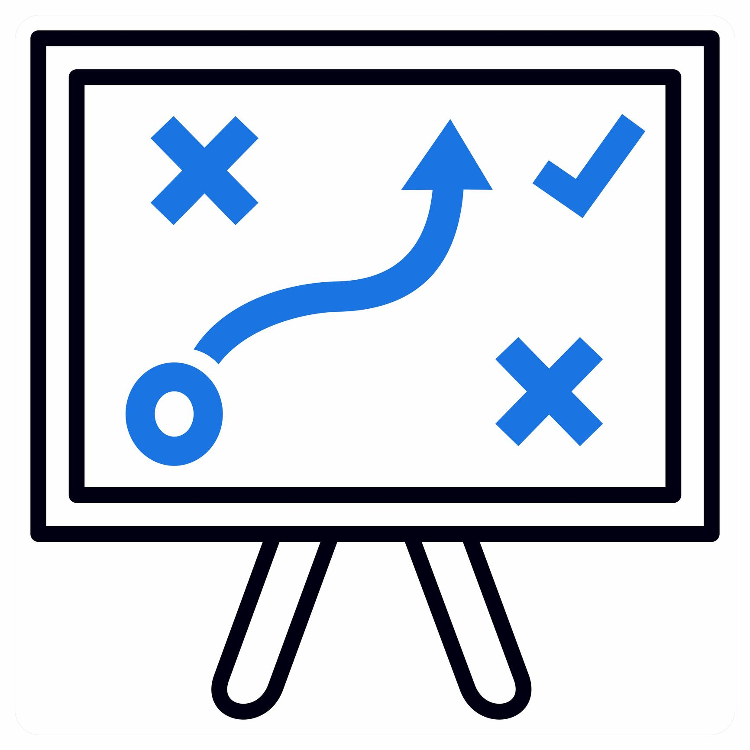
CHAPTER 2: LITERATURE SURVEY
🔹 What they do:
Doctor consultation
Medicine delivery
Lab tests
🔹 Problems in them:
Not all features in one app
Need internet always
Complex UI
Data security issues
🔹 Our improvement:
All features in one app
Works partially offline (SQLite)
Simple UI

Slide 5
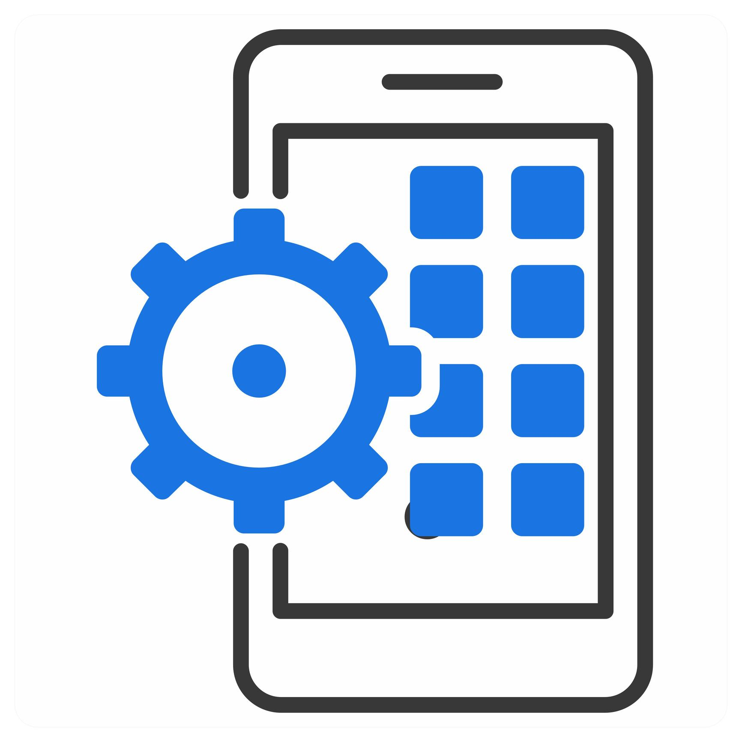
CHAPTER 3: SCOPE OF PROJECT
🔹 Technologies:
Android Studio → for development
Java → for logic
XML → for design
SQLite → for database
🔹 Algorithms (how system works):
Example:
User enters data → system checks → saves in database
🔹 System Requirements:
Android phone
Minimum RAM, storage
Works offline
🔹Functional Requirements:
Login/Register
Doctor search
Appointment booking
Lab test booking
Medicine order
🔹 Non-Functional:
Fast performance
Secure data
Easy UI

Slide 6
CHAPTER 4: METHODOLOGY
The Waterfall Model is a software development process where work is done step by step in a fixed order.
🔹 Steps:
1. Requirement Analysis
Understand user needs
2. Design
Plan UI and database
3. Implementation
Write code (Java + XML)
4. Testing
Check errors and fix
5. Deployment
Run app on mobile
6. Maintenance
Improve app later

Slide 7

CHAPTER 5: DESIGN & WORKING
🔹 Architecture (3 parts):
1. Frontend
What user sees
XML + Java
2. Backend
SQLite database
Stores all data
3. Logic
Java code connects UI and database
🔹 Data Flow:
👉 Example:
User login → data goes to database → verify → show result
🔹 Use Case:
Patient:
Login
Search doctor
Book appointment
Order medicine
Doctor:
View appointments
Update reports
Manage patients
🔹 Working Process (Step-by-step):
User registers
Login
Goes to dashboard
Books appointment
Doctor sees request
Accept/reject
Data stored in database

Slide 8
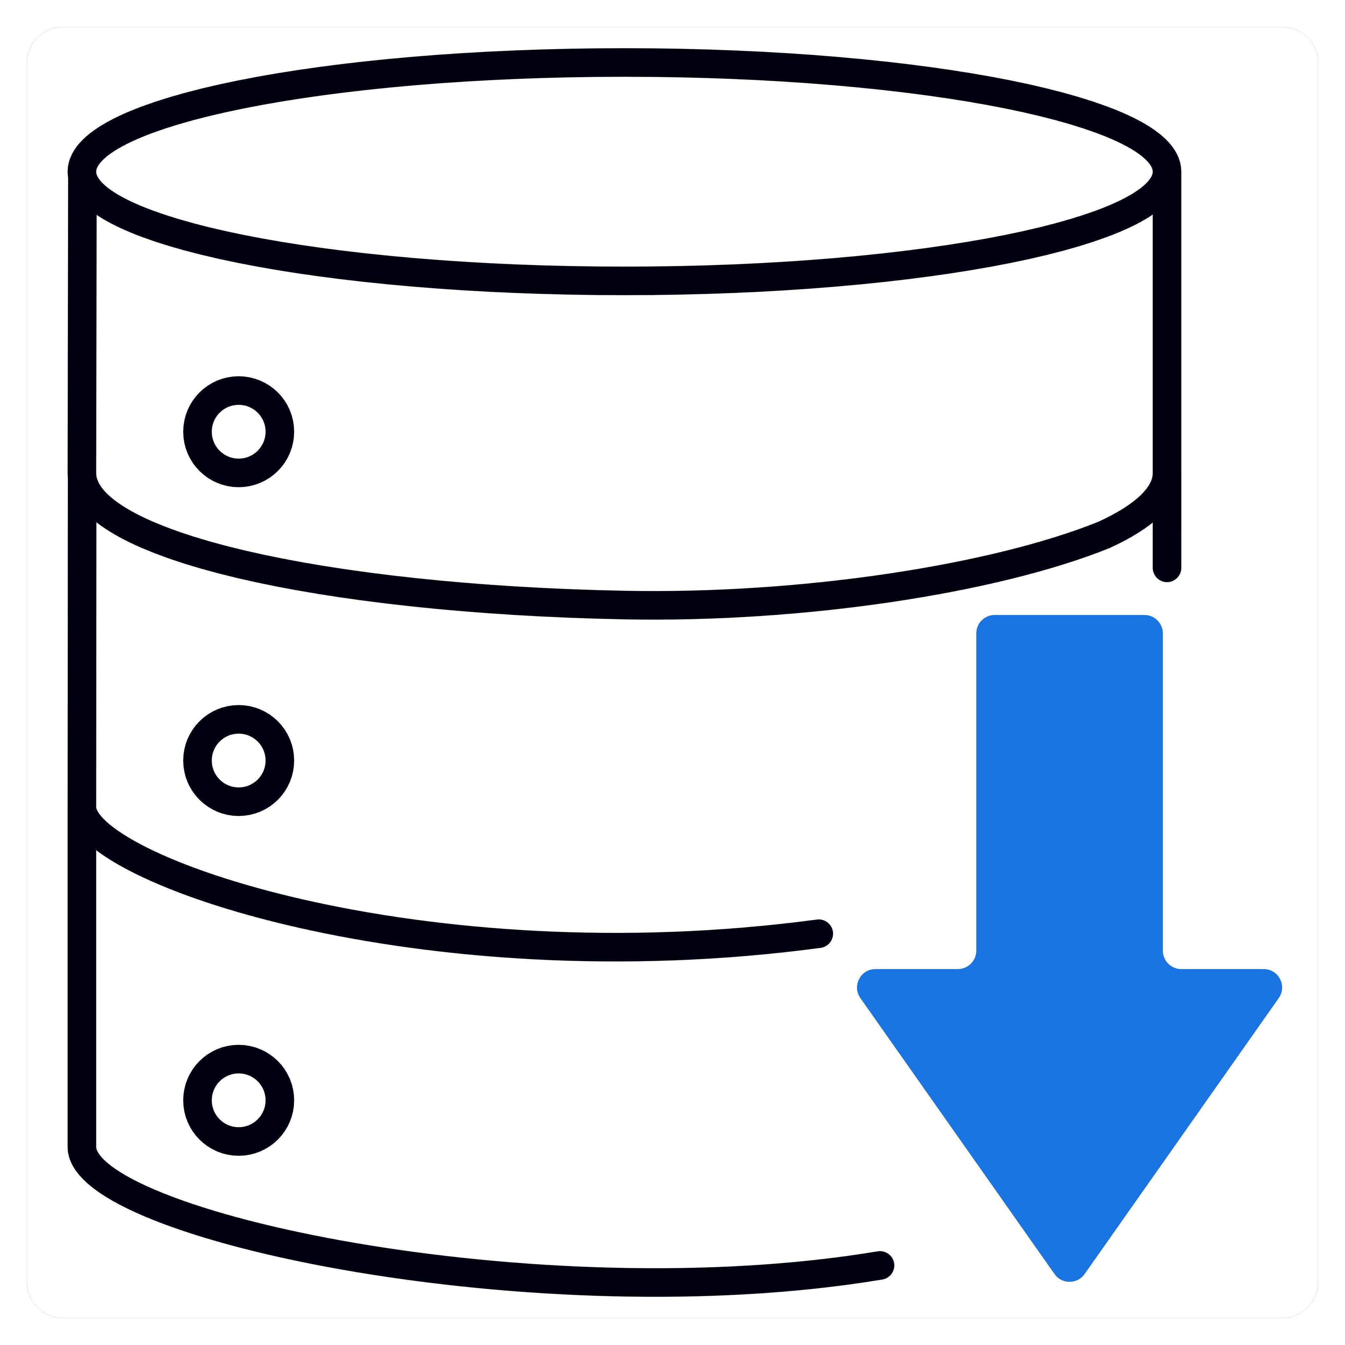
CHAPTER 6: RESULTS & APPLICATION
Results:
App works successfully
All features implemented
🔹 Patient output:
Can book, order, view history
🔹 Doctor output:
Can manage patients
🔹 Real-world use:
Hospitals
Clinics
Online consultation

Slide 9


Technology Stack
Development Tools
Android Studio
Java Programming Language
XML for UI Design
SQLite Database
System Architecture
Frontend → Android UI (XML + Java)
Backend → SQLite Database
Logic → Java Activities

Slide 10
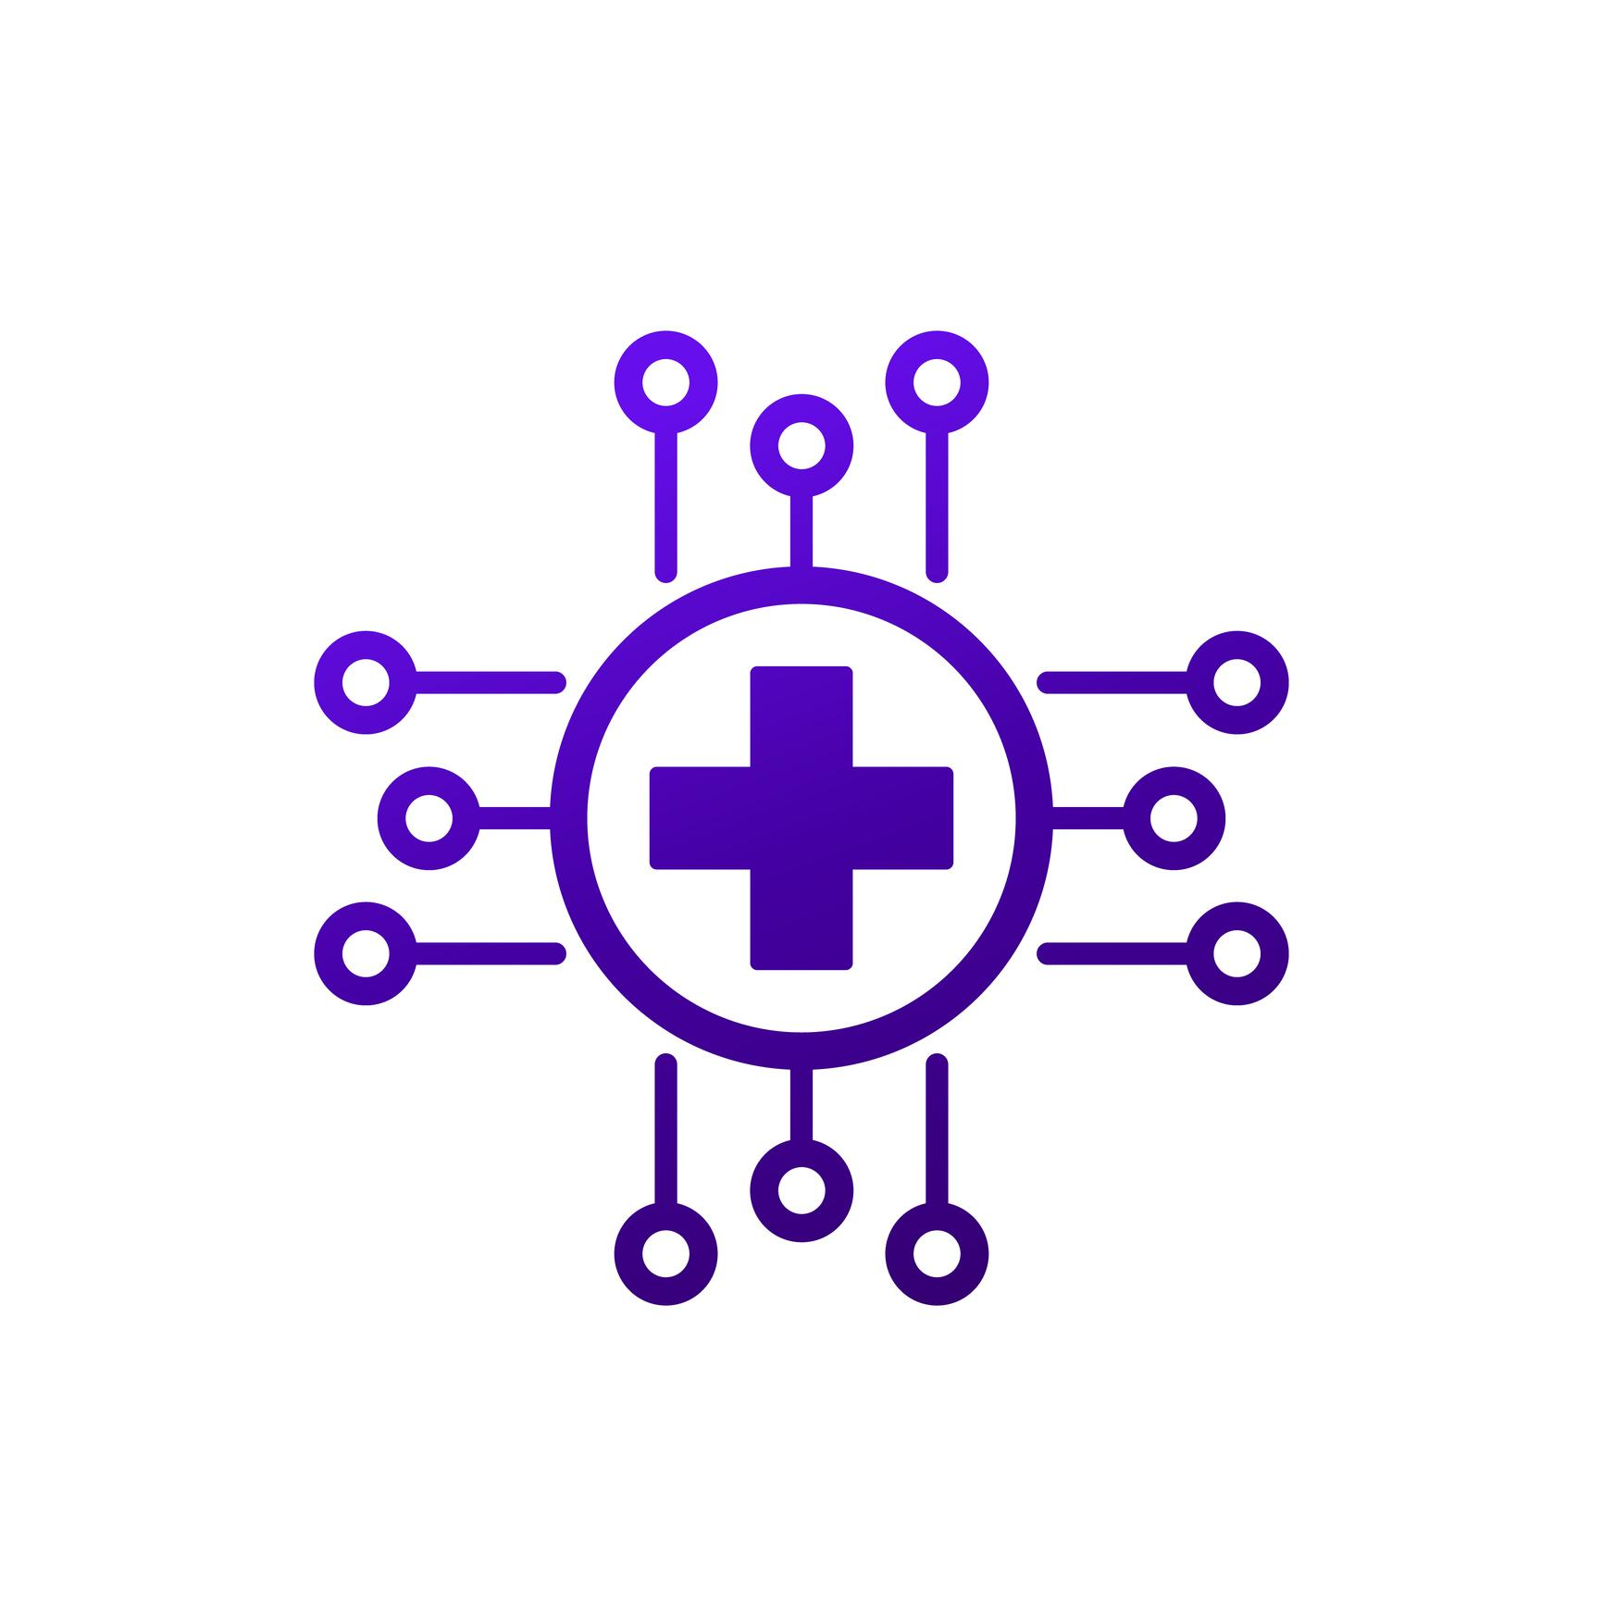
Advantages & Future Enhancement
Advantages
✔ User-friendly interface
✔ Time-saving
✔ Centralized healthcare platform
✔ Digital record maintenance
✔ Efficient appointment management
Future Enhancements
Online Payment Integration
Video Consultation Feature
Cloud Database (Firebase)
Push Notifications
AI-based Health Suggestions

Slide 11
KEY FEATURES
Secure Login System
Role-based access
Appointment Management
Lab Test Booking
Medicine Purchase
Doctor Dashboard

Slide 12
Conclusion
The system successfully provides a digital healthcare solution. It reduces manual work and improves accessibility for both patients and doctors.
Doctor Search
Appointment Booking
Lab Test Management
Medicine Ordering
Patient Record Maintenance
This project demonstrates practical knowledge of:
Android Development
Database Management
UI/UX Design
Software Architecture

